Slide 1
Troubleshooting DeadLocks
By
Sarabpreet Singh Anand

Slide 2
Sarabpreet Singh Anand
SQL Server MVP
MCTS, MCITP: Admin, MCT certifications
Vice President & Co-Founder of SQLServerGeeks.com
Expert in handling VLDBs & Disaster Management
Conducted many SQL Server Boot camp Trainings
Regular Speaker:
UG Events, In-person Events & Webcasts
Microsoft Community Tech Days (CTD),Etc
Follow Me @Sarab_SQLGeek
Email : sarab@sarabpreet.com
sarabpreet.anand@gmail.com

Slide 3
Agenda
Whats Locking and Blocking.
What is Deadlock
Diff Types of Deadlock
Diff ways to Track Deadlock info
How to read Deadlock Graphs & XML
How to avoid Deadlocks or Make your application Deadlock Smart.

Slide 4
Do you know something about
→ Locks
→ Blocking
LockMode
Isolation Levels

Slide 5
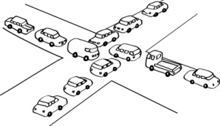
Have you ever faced Deadlock?

Slide 6
Have you seen this before?

Slide 7
Let’s see how to
Witness Deadlock
Reverse Object Deadlock
Bookmark Lookup Deadlock
Different Ways to Get\Track Deadlocks
Read\Parse Deadlocks
What does this means?
Ways to Avoid a Application Break caused by DeadLock.
Notes:
7

Slide 9
Thank you ☺
Request you to provide your valuable feedback @ http://feedback.sarabpreet.com
@Sarab_SQLGeek
Sarab@Sarabpreet.com
Sarabpreet.anand@gmail.com

