Slide 1
Introduction to SSIS: Project Deployment
By
Jayaraj Vemula
Twitter: @SQLServerGeeks www.facebook.com/groups/thesqlgeeks

Slide 2
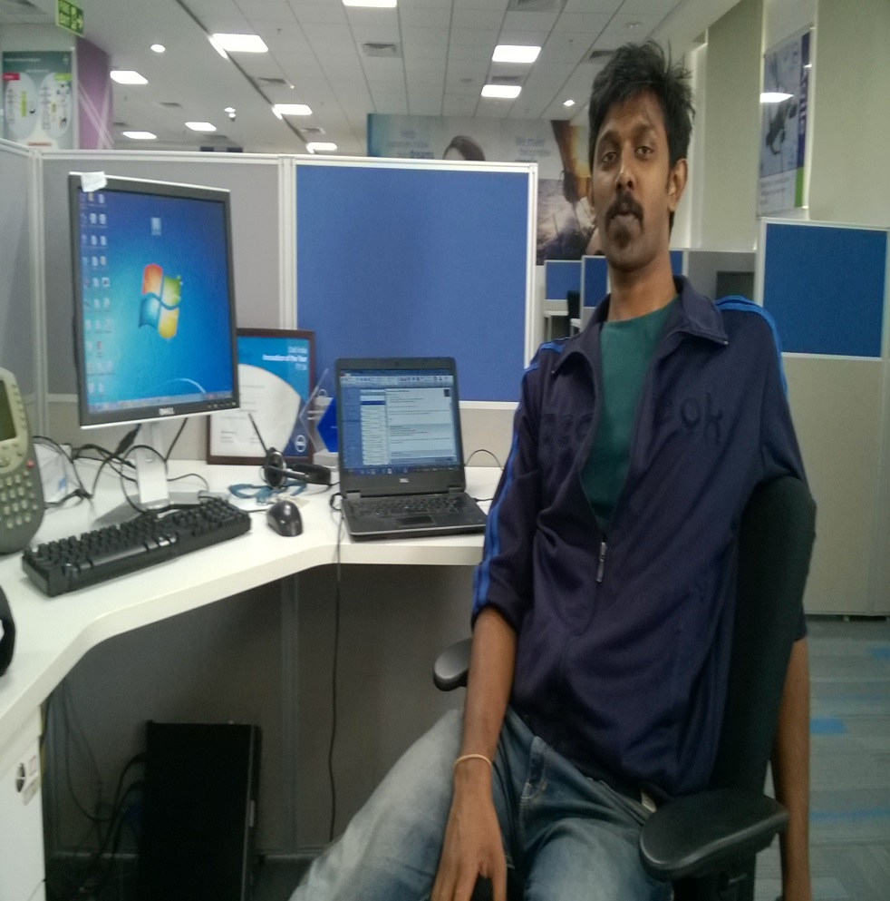
Speaker Details
Senior Database Administrator @ Dell International Service Pvt. Ltd
Blogger (He is exploring new blogging platforms - suggest one ☺)
https://sqlmash.wordpress.com/
Pro-Automation Geek
Likes to follow Technological Trends in AI(Artificial Intelligence) and Big Data
Can reach him @JayarajVemula (Twitter) or jayaraj.vemula@gmail.com
Has a kid aged 3 years to trouble him ☺ and a wife to help spend what he earned ☺
Recent Hobby : Runs everyday Morning to check robustness of his new pair of shoes ☺
Twitter: @SQLServerGeeks www.facebook.com/groups/thesqlgeeks

Slide 3
Agenda
Brief Introduction to SSIS
SSIS Prior to SQL 2012 (Package Deployment Model)
SSIS from SQL 2012 (Project Deployment Model)
Q&A
Twitter: @SQLServerGeeks www.facebook.com/groups/thesqlgeeks

Slide 4
How many use PS?
Why should I use PS?
Twitter: @SQLServerGeeks www.facebook.com/groups/thesqlgeeks

Slide 5
Brief Introduction to SSIS
What and why ?
E xtract
T ransform
L oad
Twitter: @SQLServerGeeks www.facebook.com/groups/thesqlgeeks
Notes:
ETL
SQL 2005
Introduction to SSIS :
https://msdn.microsoft.com/en-us/library/cc505845.aspx
http://www.mssqltips.com/sqlservertutorial/200/sql-server-integration-services-ssis/
Import/Export Wizard is a simple startup to learn SSIS

Slide 6
SSIS Package Deployment Model
(Quick Demo)
Create
Deploy
Test
Twitter: @SQLServerGeeks www.facebook.com/groups/thesqlgeeks
Notes:
SSIS for Beginners: http://www.mssqltips.com/sqlservertutorial/200/sql-server-integration-services-ssis/
OLEDB VS ADO.NET
https://social.msdn.microsoft.com/forums/sqlserver/en-US/1a9e3670-9685-4943-913b-123ecf248a9c/ole-db-vs-adonet

Slide 7
SSIS Project Deployment Model
(Quick Demo)
Create
Deploy
Test
Twitter: @SQLServerGeeks www.facebook.com/groups/thesqlgeeks
Notes:
https://www.simple-talk.com/sql/ssis/ssis-2012-projects-setup,-project-creation-and-deployment/
https://www.simple-talk.com/sql/ssis/ssis-2012-projects-deployment-configurations-and-monitoring/

Slide 8
Q & A
Twitter: @SQLServerGeeks www.facebook.com/groups/thesqlgeeks

Slide 9
Thank you ☺
for suggestions and feedback, please email at admin@SQLServerGeeks.com
Twitter: @SQLServerGeeks www.facebook.com/groups/thesqlgeeks

